Slide 1
Automated Variable Selection of Gamma-Ray Spectra by Utilization of LASSO and Elastic Net Techniques for Use in Nuclear Security Applications
Vincent DiNova
NC State University
Preliminary Examination
February 21, 2019
Raleigh, NC

Slide 2
Agenda
Mission of RDRS
Experimental setup and operation
Prompt Gamma Neutron Activation Analysis (PGNAA)
Neutron, gamma, and detector physics
Monte Carlo Library Least Squares (MCLLS) fitting
Basics of supervised machine learning
Regularization methods (LASSO and Elastic Net)
Library generation and data processing
KSU results
Continuing work on KSU benchmarking tool
RIID simulation
Preliminary results
Work summary/proposal
References
Questions

Slide 3
Replacement of Dangerous Radiological Sources
One of the thrust areas under the Consortium for Nonproliferation Enabling Capabilities (CNEC) tasked with finding suitable alternatives for commonly used radioisotopes
NC State’s contribution to RDRS is to:
Develop a practical inverse approach to determine elemental composition, density, and neutron porosity with a 14-MeV neutron well logging tool using adapted Monte Carlo Library Least-Squares methods.
Benchmark these methods with data obtained from KSU’s test facility and test tool. This tool replaces the two present radioisotope sources in traditional well-logging tools with a single 14-MeV neutron generator.

Slide 4
Motivation
The National Academy of Sciences (NAS) commissioned a study soon after 9/11/2001 to consider the dangers of long-lived radiological sources:
Radionuclide | Half-life (yr) | Particles-Energies (MeV) | Principal Applications | US Inventory (Ci)
Cs-137 | 30.17 | β-0.518 max; β-1.18 max; γ-0.662 | Industrial gauging, Irradiators, Well logging | 2,800,000
Co-60 | 5.27 | γ-1.173; γ-1.333 | Sterilization, Irradiators, Teletherapy | 198,000,000
Am-241 | 432.2 | α-5.64; γ-0.060 | Well logging, Gauging | 6,482
Pu-238 | 87.7 | α-5.59; γ-0.043 | RTGs | 937
Sr-90 | 28.9 | β-0.546 max | RTGs | 1,730,000
Se-75 | 119.8 d | γ-0.28 (ave), 0.8 max | Radiography | 261
Ir-192 | 74 d | β-1.46 max] γ-0.38 ave, 1.378 max | Radiography | 146,922
Cf-252 | 2.645 | α-6.22; n-2 ave; γ-various; fission products | Well logging Research | 7

Slide 5
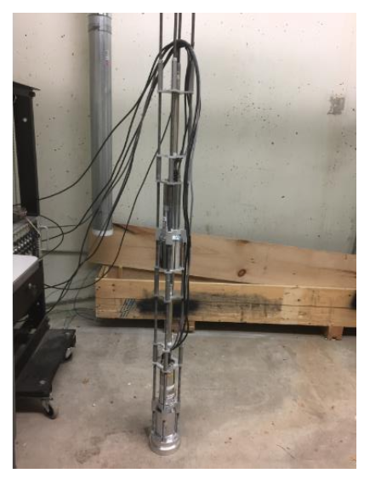
Benchmarking Tool Design
The benchmarking tool:
Skeleton
Sources
Shielding
Sensors
For the well-logging application:
Thermo Fisher D-T generator
BF₃ and ³He neutron sensors
NaI(Tl) gamma sensors
Tool is used to benchmark Monte Carlo simulation results
Distances in inches, from target to centroid of active detection material
65.37’’
47.09’’
34.58’’
17.27’’
NaI(Tl)
Helium-3
NaI(Tl)
BF3
2’’ Lead
Accelerator’s Target
The Skeleton with only sensors

Slide 6

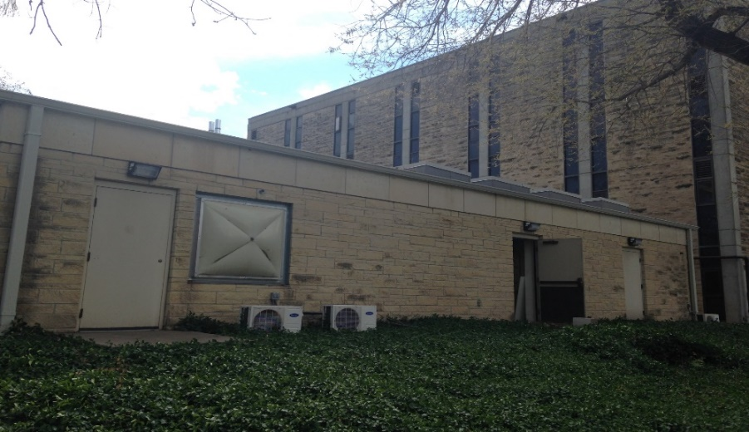
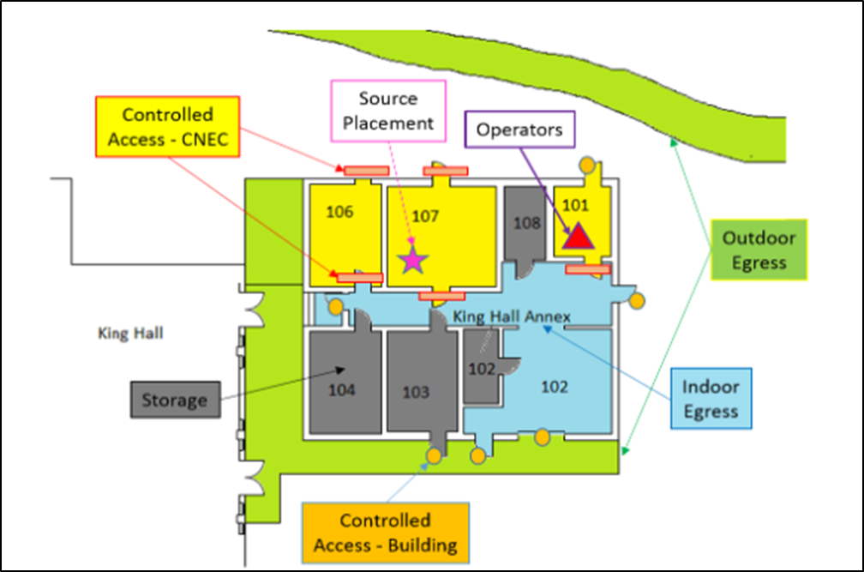
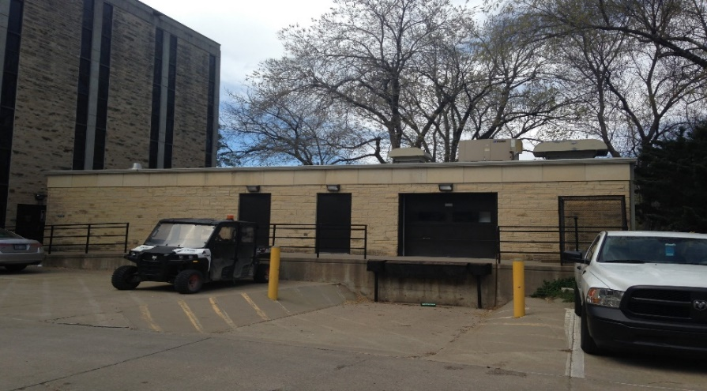
Test Facility: Location
The KSUMI Test Facility is at King Hall Annex at KSU
N
Room 101
Room 107
North Side View
Facility Floor Plan
South Side View

Slide 7
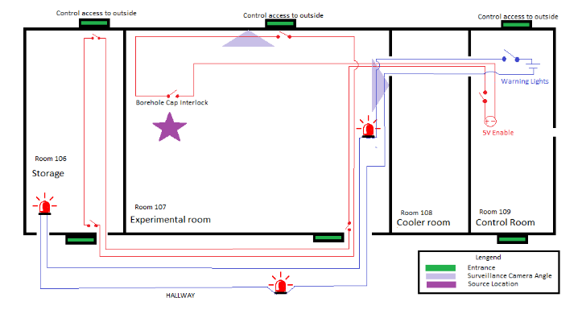
Test Facility: Accelerator Enabling and Safeguard Systems
N
Accelerator Enabling System prevents inadvertent neutron production and entries
Other Safeguards include:
Surveillance
Intercommunication
Warning lights
Procedures
Low dosage for bystanders and workers. Only workers who enters experiment room requires dosimeters.
Source
Storage
Test Chamber
Experimental Room
Cooler
Control Station
Hallway
D-T generator’s Target
Video & Audio Surveillance
Controlled Access

Slide 8
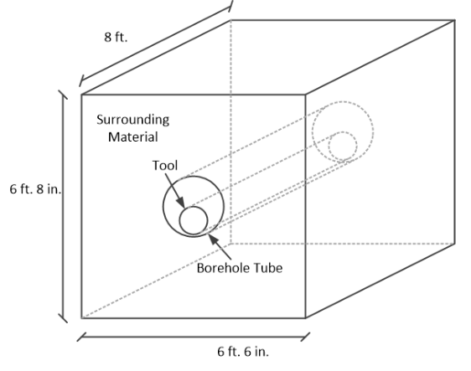
Test Facility: Test Chamber Design
The test chamber is 6’-8” high by 6’-6” wide by 8’ deep
Volume inside the chamber is ~2,500 gal
When filled with water, the chamber presents an effectively infinite medium to the D-T neutrons
Tool goes inside the borehole tube which is surrounded by a medium such as air, water, sand, or limestone chips.
Test Chamber dimensions

Slide 9
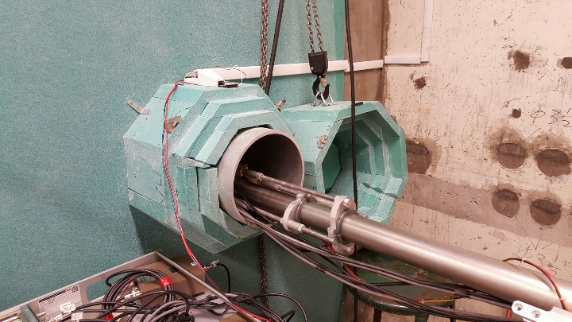
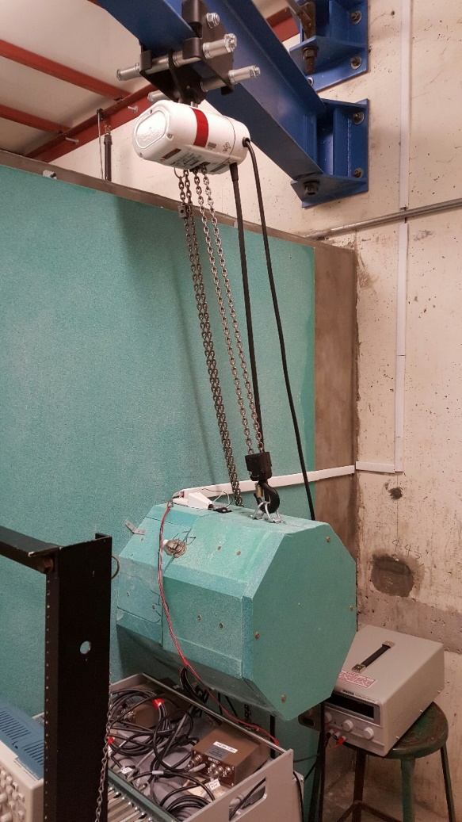
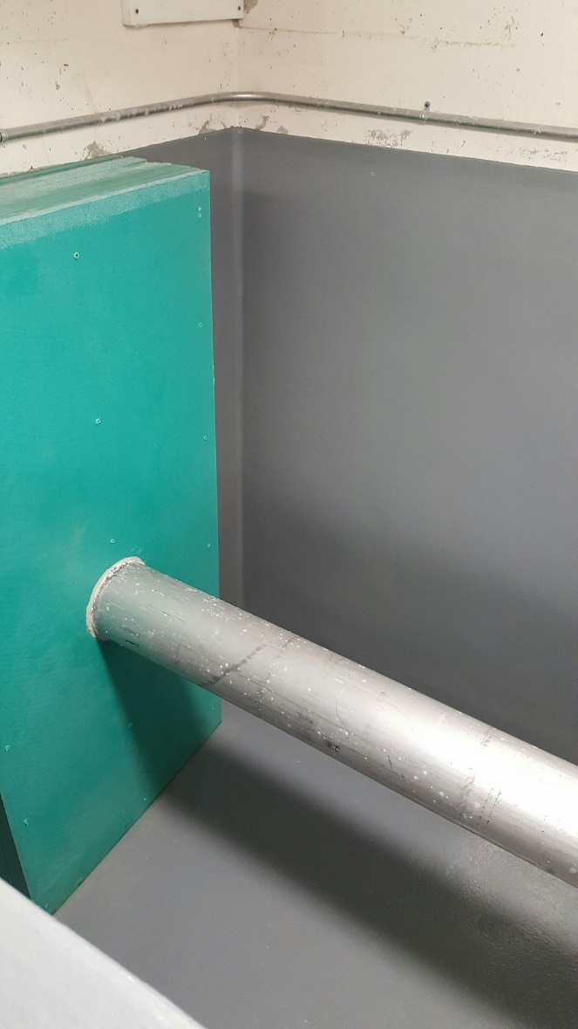
Test Facility: Test Chamber with Benchmark Tool
Shield Cap Interlock
Generator and tool inserting the chamber’s borehole tube
½ ton crane
Borehole tube
Open Borehole tube
Green objects are borated polyethylene
Test chamber is currently outfitted to benchmark the logging tool
Ready for measurements
Inside The Chamber

Slide 10
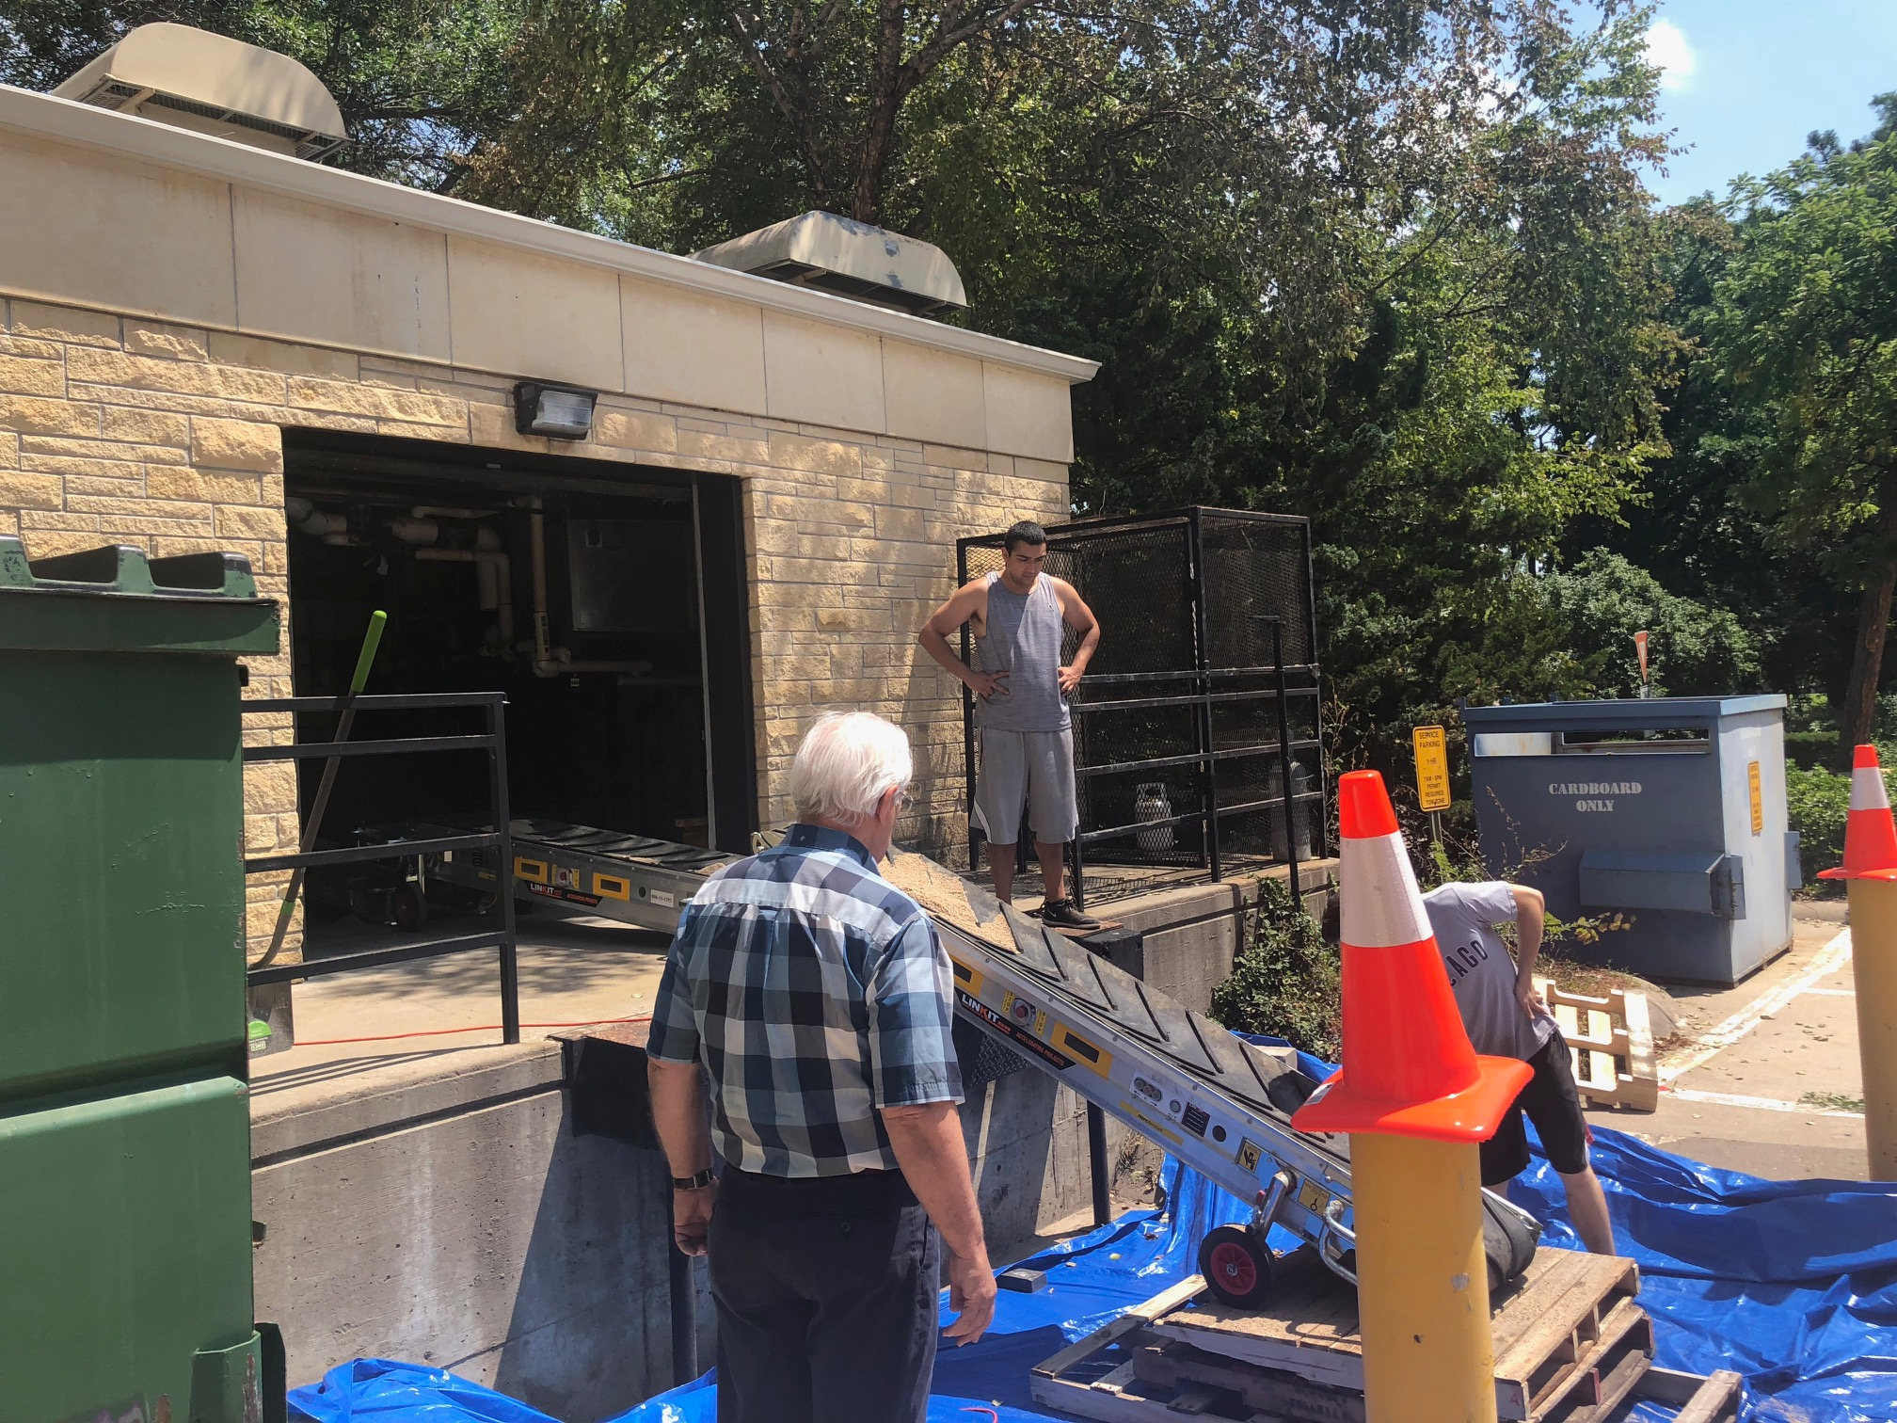
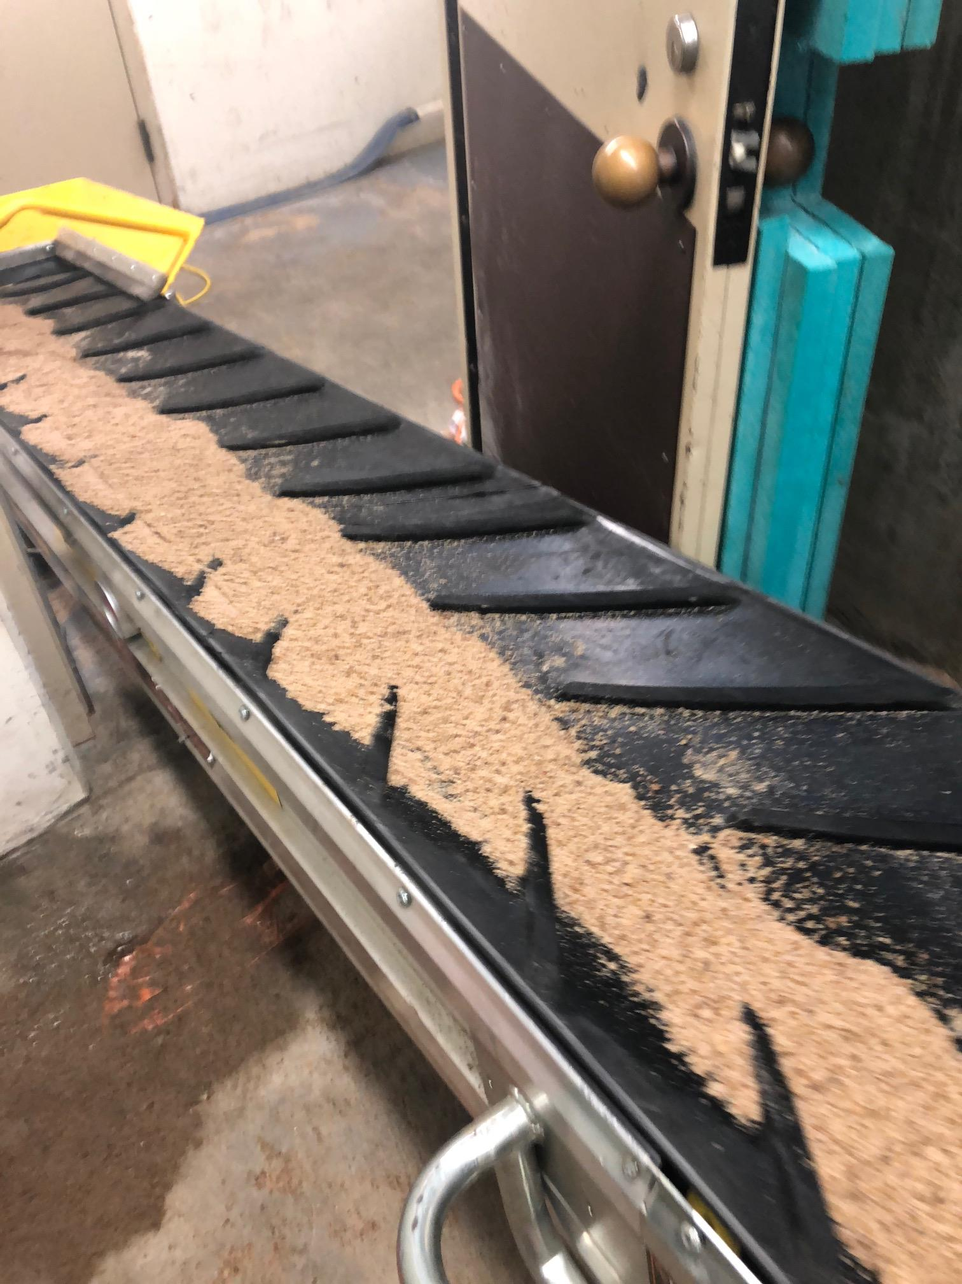

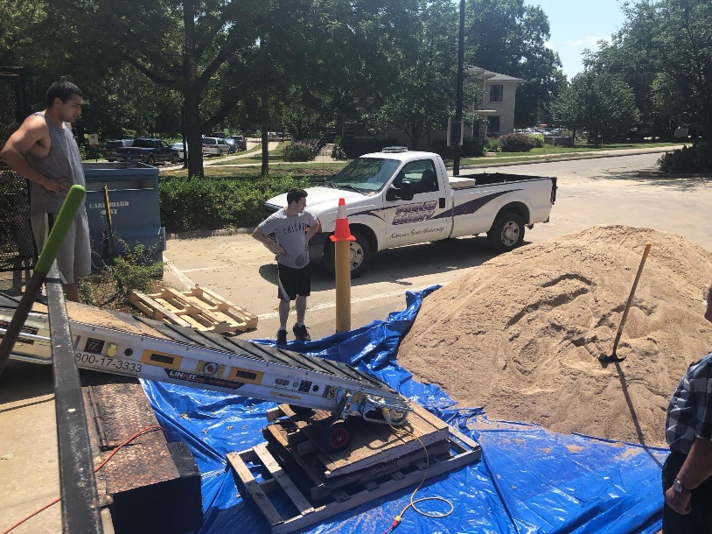
Test Facility: Material Loading
Conveyor Belt system for material movement
Safety Evaluation
Test Chamber material leveling

Slide 11
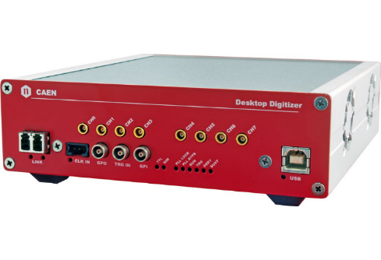
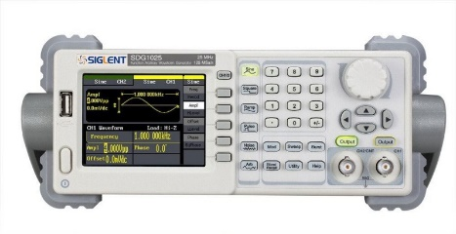
Test Facility: Data Acquisition Scheme
Physics
G-far
N-far
G-near
N-near
D-T Gen
Ch3
Ch2
Ch1
Ch0
Ch4
Ch1
Ch2
CAEN5730 Digitizer
Function generator
Fiber Optic
PC
Output text options:
List Mode in ASCII format
List Mode in binary format
Data Acquisition Scheme

Slide 12
Neutron Interactions
γ
INELASTIC SCATTERING
γ
THERMAL CAPTURE
NEUTRON ACTIVATION

Slide 13
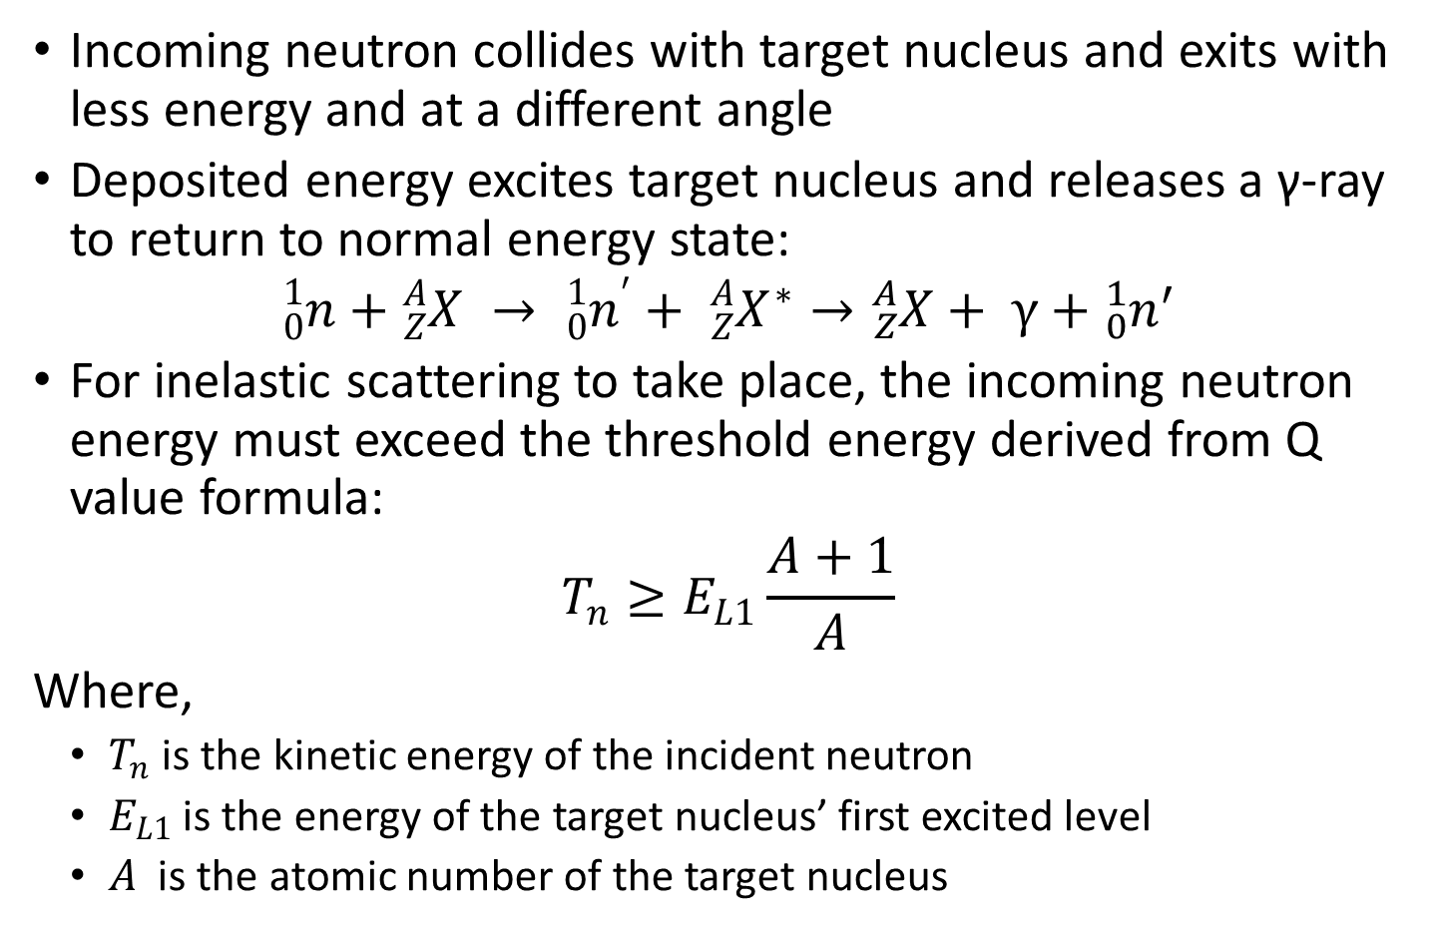
Neutron Inelastic Scatter (n,n’γ)
Incoming neutron collides with target nucleus and exits with less energy and at a different angle
Deposited energy excites target nucleus and releases a γ-ray to return to normal energy state:
$${}_{0}^{1}n+{}_{Z}^{A}X → {{}_{0}^{1}n}^{′}+ {{}_{Z}^{A}X}^{∗}→{}_{Z}^{A}X+ γ+{{}_{0}^{1}n}^{′}$$
For inelastic scattering to take place, the incoming neutron energy must exceed the threshold energy derived from Q value formula:
$$T_{n}≥E_{L1}\frac{A+1}{A}$$
Where,
$T_{n}$ is the kinetic energy of the incident neutron
$E_{L1}$ is the energy of the target nucleus’ first excited level
$A$ is the atomic number of the target nucleus

Slide 14
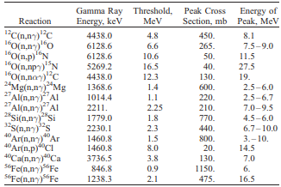
Common Non-elastic Scattering Reactions
Note: Hydrogen does not give off inelastic scatter photons

Slide 15
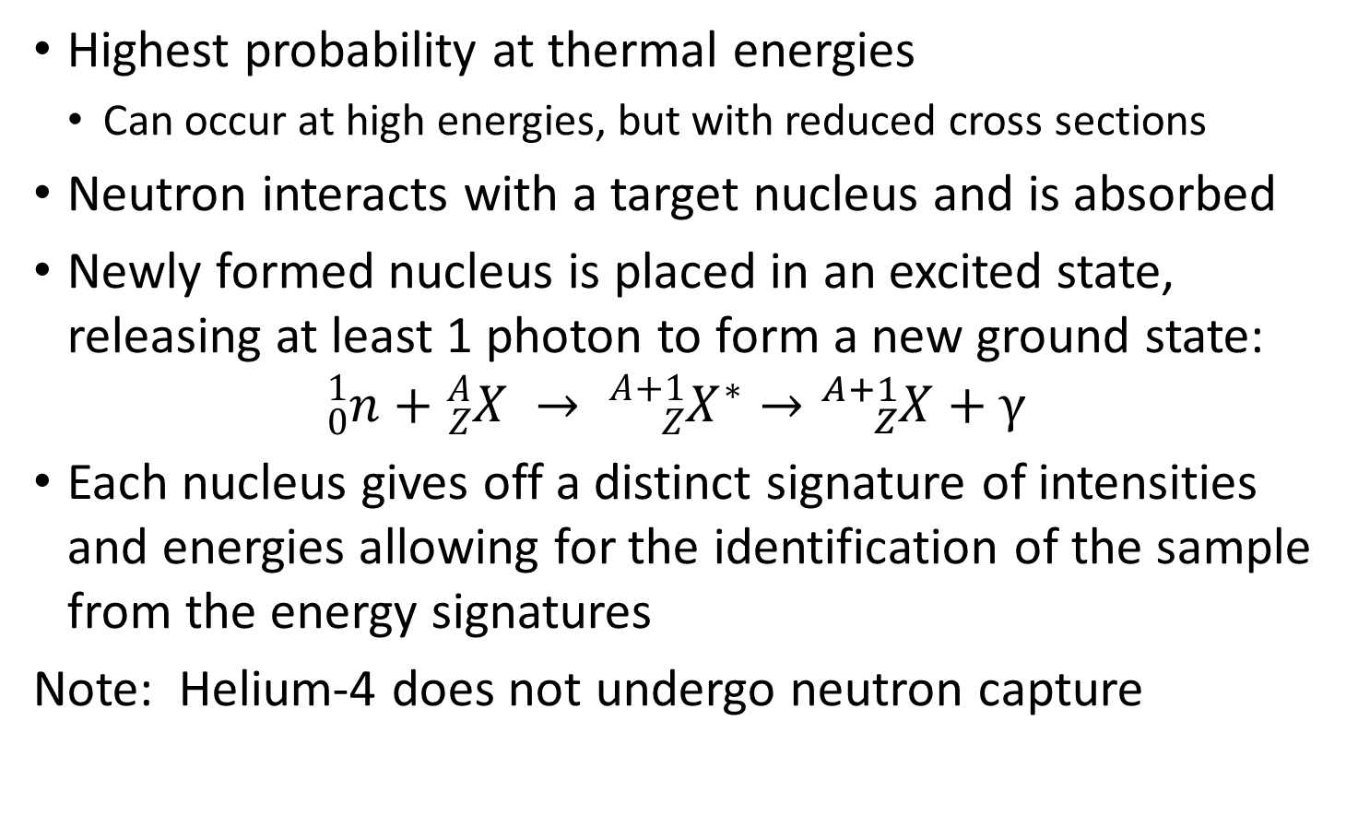
Neutron Capture (n,γ)
Highest probability at thermal energies
Can occur at high energies, but with reduced cross sections
Neutron interacts with a target nucleus and is absorbed
Newly formed nucleus is placed in an excited state, releasing at least 1 photon to form a new ground state:
$${}_{0}^{1}n+{}_{Z}^{A}X → {{}_{Z}^{A+1}X}^{∗}→{}_{Z}^{A+1}{X+γ}$$
Each nucleus gives off a distinct signature of intensities and energies allowing for the identification of the sample from the energy signatures
Note: Helium-4 does not undergo neutron capture

Slide 16
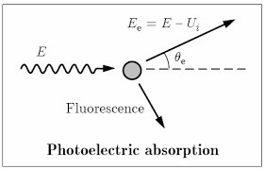
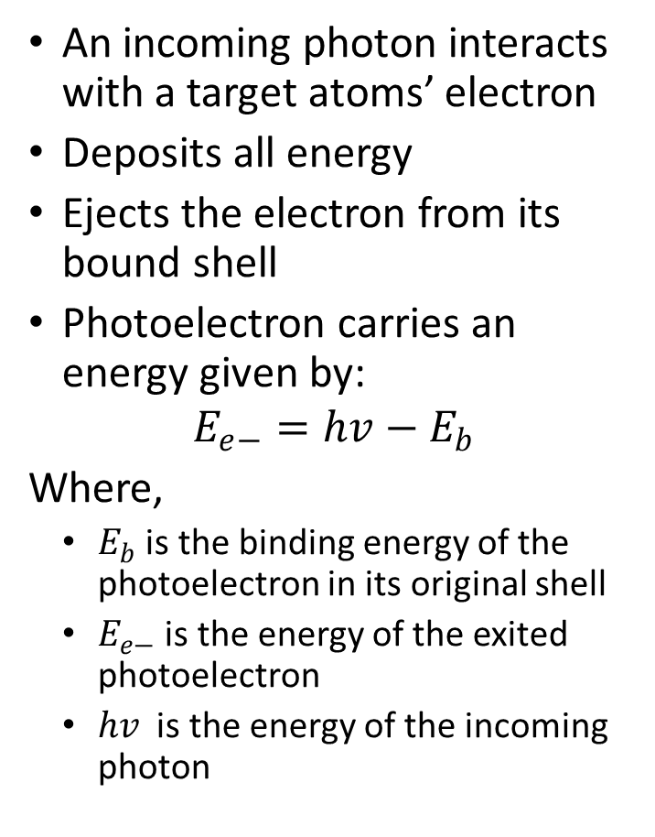
Photon Physics – Photoelectric Absorption
An incoming photon interacts with a target atoms’ electron
Deposits all energy
Ejects the electron from its bound shell
Photoelectron carries an energy given by:
$$E_{e−}=hv−E_{b}$$
Where,
$E_{b}$ is the binding energy of the photoelectron in its original shell
$E_{e−}$ is the energy of the exited photoelectron
$hv$ is the energy of the incoming photon

Slide 17
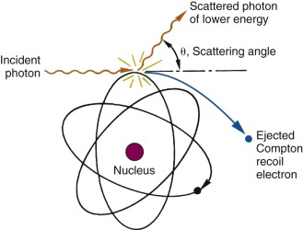
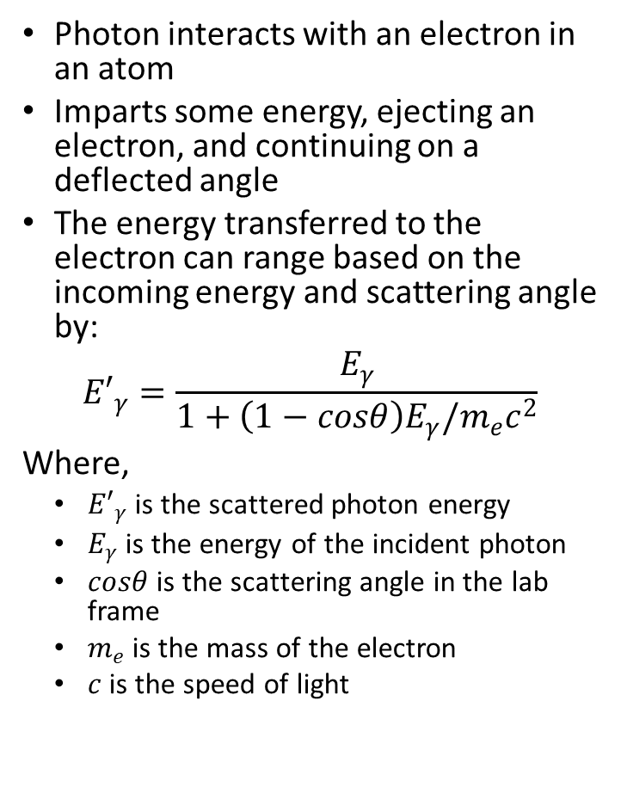
Photon Physics – Compton Scattering
Photon interacts with an electron in an atom
Imparts some energy, ejecting an electron, and continuing on a deflected angle
The energy transferred to the electron can range based on the incoming energy and scattering angle by:
$${E′}_{γ}=\frac{E_{γ}}{1+\left(1−cosθ\right)E_{γ}/m_{e}c^{2}}$$
Where,
${E′}_{γ}$ is the scattered photon energy
$E_{γ}$ is the energy of the incident photon
$cosθ$is the scattering angle in the lab frame
$m_{e}$ is the mass of the electron
$c$is the speed of light

Slide 18
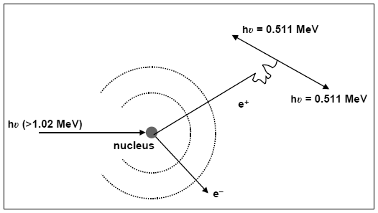
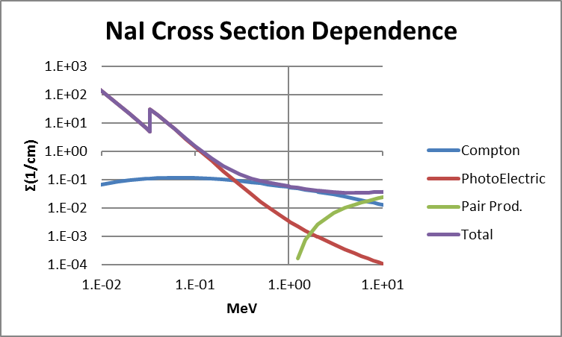
Photon Physics – Pair Production
When an incoming photon exceeds 1.02 MeV, pair production can occur
Photon becomes near the nucleus, energy is converted into an electron-positron pair
Positron will interact with nearby electron creating 2 annihilation 0.511 MeV photons

Slide 19
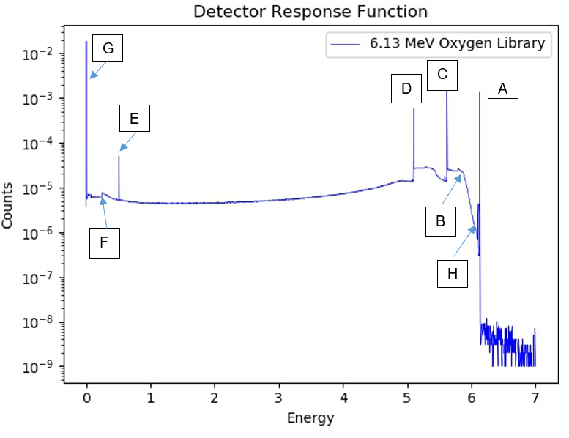
Detector Physics and Features
MCNP Simulation
F8 Tally – energy deposition
“Perfect resolution”
Oxygen-16 activation (N-16 decay)
6.130 MeV photon
7.13 second half life
Oxygen-16 inelastic scatter
6.13 MeV prompt gamma

Slide 20
Detector Response Features
A: Full Energy Peak
The full energy peak is equal to the incoming photon energy, 6.13 MeV for this example. The pulse signals that produce this signature occur when the particle enters the detector and deposits all of its energy with no escaping secondary particles. This can occur in a single photoelectric absorption or by a series of reactions. For this reason, the full energy peak can be referred to as the “photoelectric peak”.

Slide 21
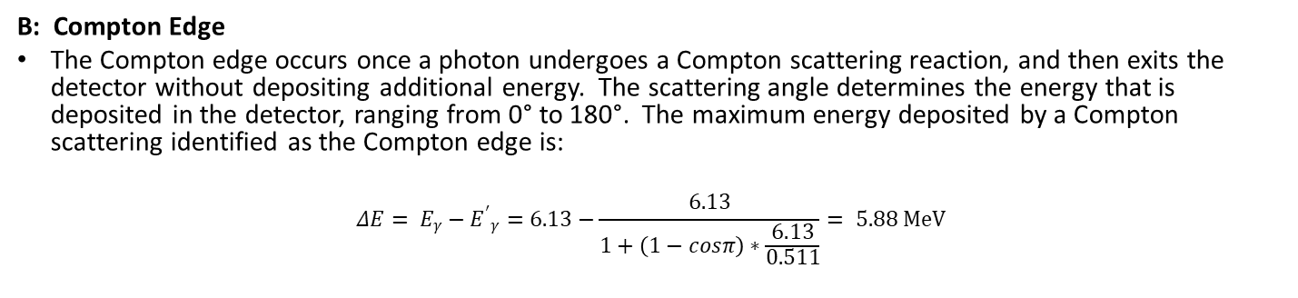
Detector Response Features
B: Compton Edge
The Compton edge occurs once a photon undergoes a Compton scattering reaction, and then exits the detector without depositing additional energy. The scattering angle determines the energy that is deposited in the detector, ranging from 0° to 180°. The maximum energy deposited by a Compton scattering identified as the Compton edge is:
$$ΔE= E_{γ}−{E^{′}}_{γ}=6.13−\frac{6.13}{1+\left(1−cosπ\right)∗\frac{6.13}{0.511}}= 5.88 MeV$$

Slide 22
Detector Response Features
C: Single Escape Peak
In the event a photon creates a pair production reaction, an electron-positron pair is created. The positron will then annihilate inside the detector, creating a 0.511 MeV photon. If the annihilation photon exits the detector without depositing its energy and the full energy of the incoming photon is deposited inside the detector, the result is the single escape peak. The energy of the peak is equal to the full energy peak minus the resting mass energy of an electron, 0.511 MeV.
D: Double Escape Peak
The double escape peak is the result of both annihilation photons escape the detector. In this way, the resulting energy is equal to that of the full energy peak minus the resting mass energy of two electrons, 1.022 MeV.

Slide 23
Detector Response Features
E: Annihilation Peak
In the event that the incoming particle interacts with a material outside of the detector by a pair production reaction, a resulting annihilation photon can enter the detector and deposit its energy. The annihilation peak appears when the detector is surrounded by a dense material and is equal to 0.511 MeV.

Slide 24
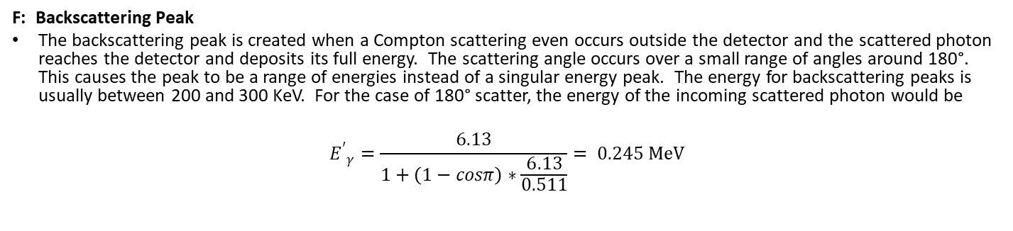
Detector Response Features
F: Backscattering Peak
The backscattering peak is created when a Compton scattering even occurs outside the detector and the scattered photon reaches the detector and deposits its full energy. The scattering angle occurs over a small range of angles around 180°. This causes the peak to be a range of energies instead of a singular energy peak. The energy for backscattering peaks is usually between 200 and 300 KeV. For the case of 180° scatter, the energy of the incoming scattered photon would be
$${E^{′}}_{γ}=\frac{6.13}{1+\left(1−cosπ\right)∗\frac{6.13}{0.511}}= 0.245 MeV$$

Slide 25
Detector Response Features
G: X-Ray Fluorescence Peaks
X-ray fluorescence peaks are not of interest to prompt gamma neutron activation analysis and contributes to a collection of noise signatures that collect below 100 KeV. These peaks are generated by interactions that occur in the surrounding medium by exciting the target atom. During the de-excitation, characteristic X-ray photons are emitted and enter the detector and deposit their full energy. These peaks complicate the fitting functions, as they can be orders of magnitude higher than other signatures within the spectrum.

Slide 26
Detector Response Features
H: X-Ray Escape Peaks
When the excited atoms discussed above are generated within the detector, an X-ray photon can exit the detector. The resulting energy response is equal to the full energy peak minus the energy carried by the exited photon. If the detector material is larger than 1”, these events happen infrequently and do not affect the total response substantially.

Slide 27
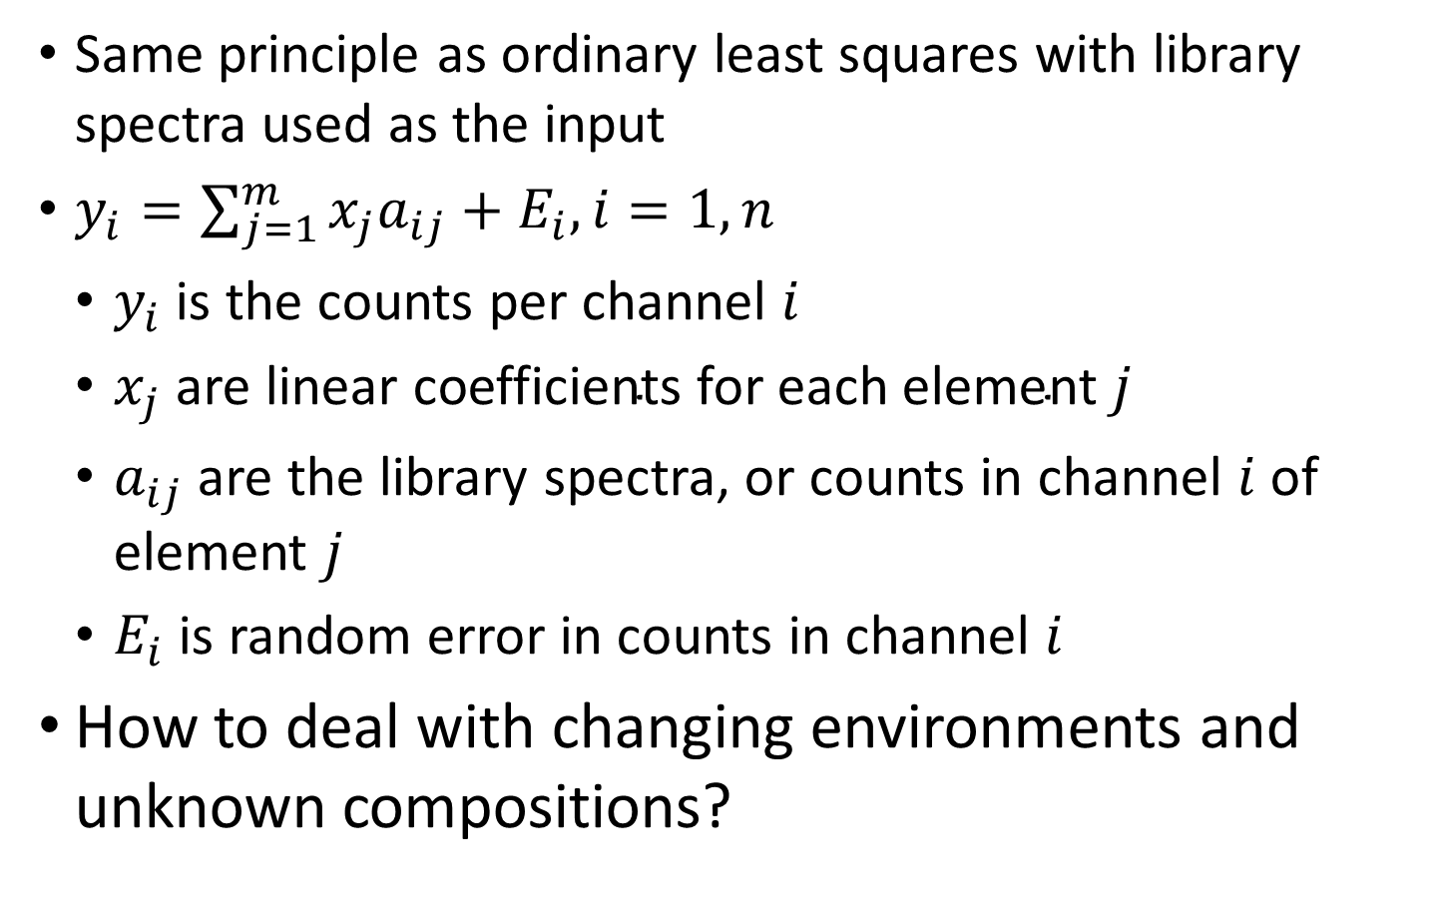
Monte Carlo Library Least Squares
Same principle as ordinary least squares with library spectra used as the input
$y_{i}=\sum_{j=1}^{m}{x_{j}a_{ij}+E_{i}, i=1,n}$
$y_{i}$ is the counts per channel $i$
$x_{j} \text{are} \text{linear} \text{coefficients} \text{for} \text{each} \text{element} j$
$a_{ij}$ are the library spectra, or counts in channel $i$ of element $j$
$E_{i}$ is random error in counts in channel $i$
How to deal with changing environments and unknown compositions?

Slide 28
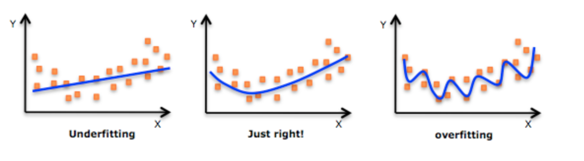
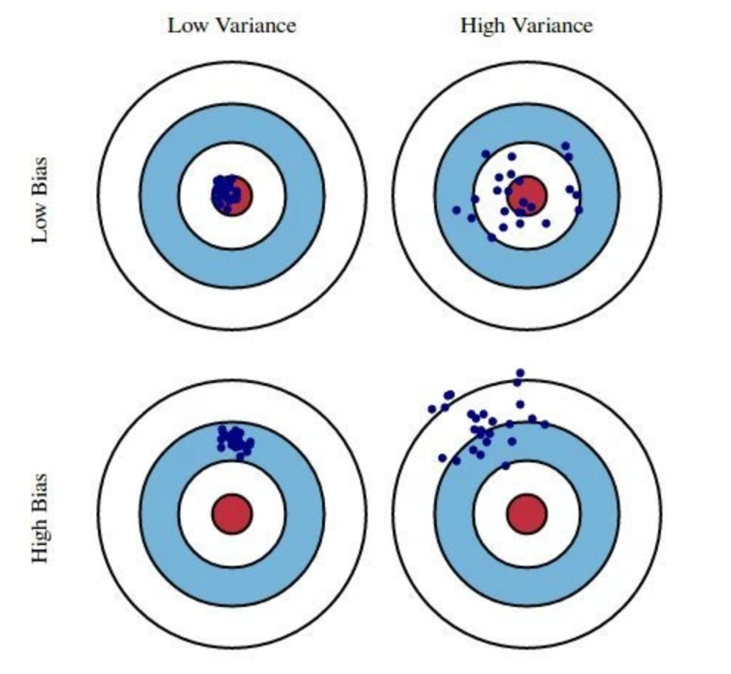
Supervised Machine Learning
Ordinary Least Squares traditionally suffers from overfitting
Too many model parameters
Model selection should have the right parameters to accurately predict/fit correct solution
Adding complexity to the model increases bias while reducing variance
Supervised machine learning variable selection techniques aim to minimize unnecessary bias and variance simultaneously by selecting the correct parameters

Slide 29
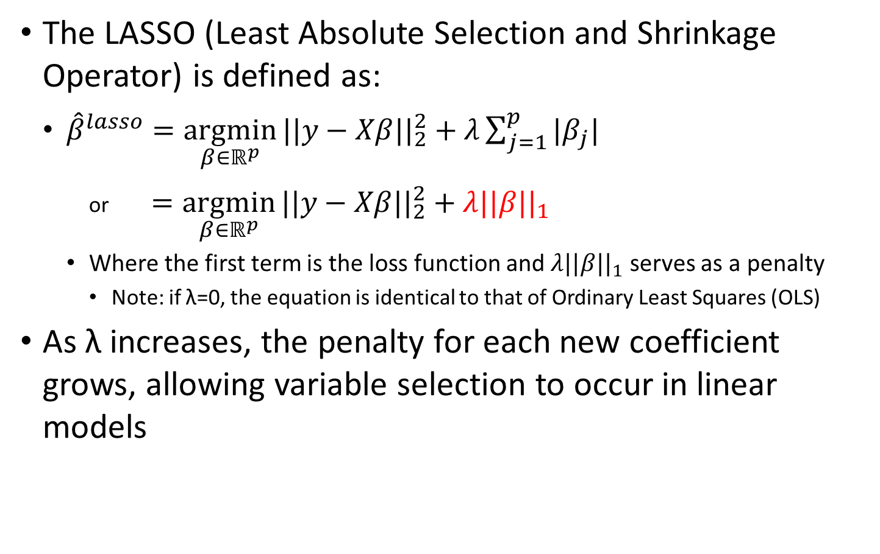
LASSO (Tibshirani, 1996)
The LASSO (Least Absolute Selection and Shrinkage Operator) is defined as:
${\hat{β}}^{lasso}=\underset{β∈ℝ^{p}}{argmin}{||y−Xβ{||}_{2}^{2}+λ\sum_{j=1}^{p}{|β_{j}|}}$
or $=\underset{β∈ℝ^{p}}{argmin}{||y−Xβ{||}_{2}^{2}}+λ||β{||}_{1}$
Where the first term is the loss function and $λ||β{||}_{1}$ serves as a penalty
Note: if λ=0, the equation is identical to that of Ordinary Least Squares (OLS)
As λ increases, the penalty for each new coefficient grows, allowing variable selection to occur in linear models

Slide 30
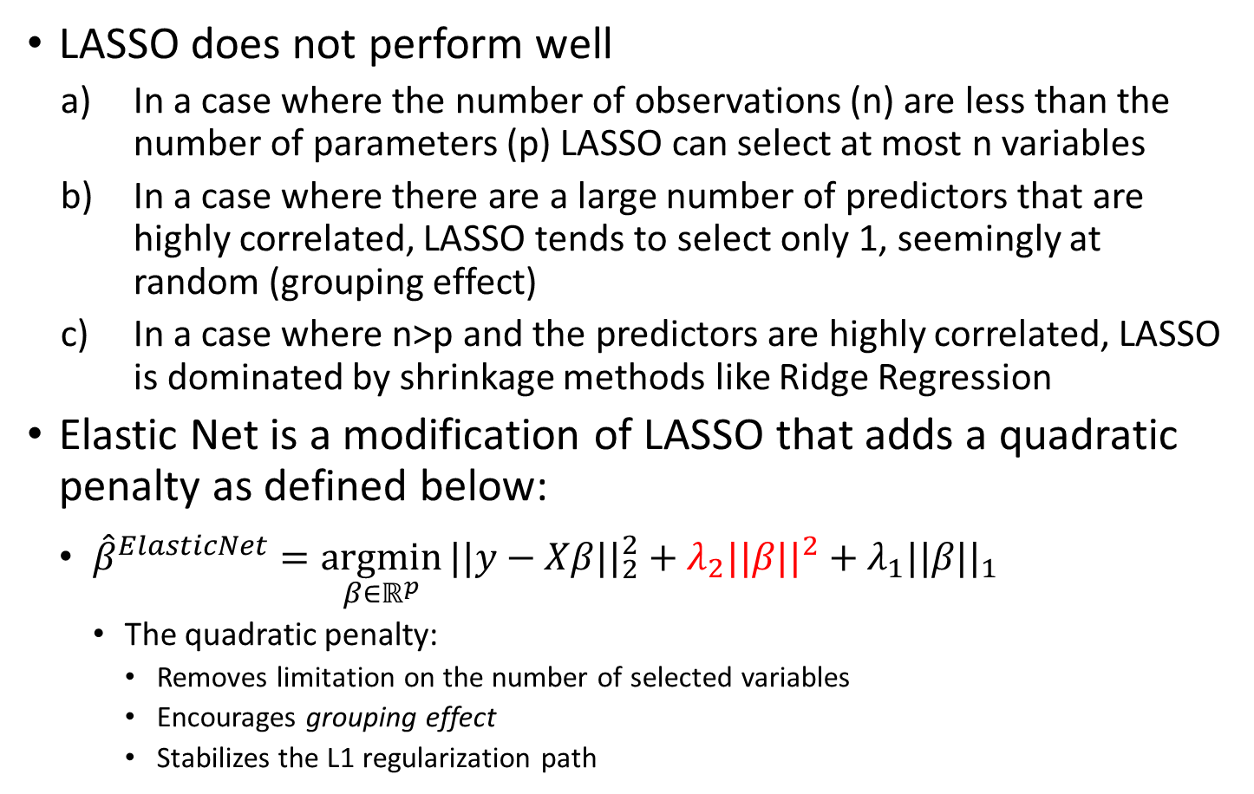
Elastic Net (Zou and Hastie, 2005)
LASSO does not perform well
In a case where the number of observations (n) are less than the number of parameters (p) LASSO can select at most n variables
In a case where there are a large number of predictors that are highly correlated, LASSO tends to select only 1, seemingly at random (grouping effect)
In a case where n>p and the predictors are highly correlated, LASSO is dominated by shrinkage methods like Ridge Regression
Elastic Net is a modification of LASSO that adds a quadratic penalty as defined below:
${\hat{β}}^{ElasticNet}=\underset{β∈ℝ^{p}}{argmin}{||y−Xβ{||}_{2}^{2}}+λ_{2}||β{||}^{2}+λ_{1}||β{||}_{1}$
The quadratic penalty:
Removes limitation on the number of selected variables
Encourages grouping effect
Stabilizes the L1 regularization path

Slide 31
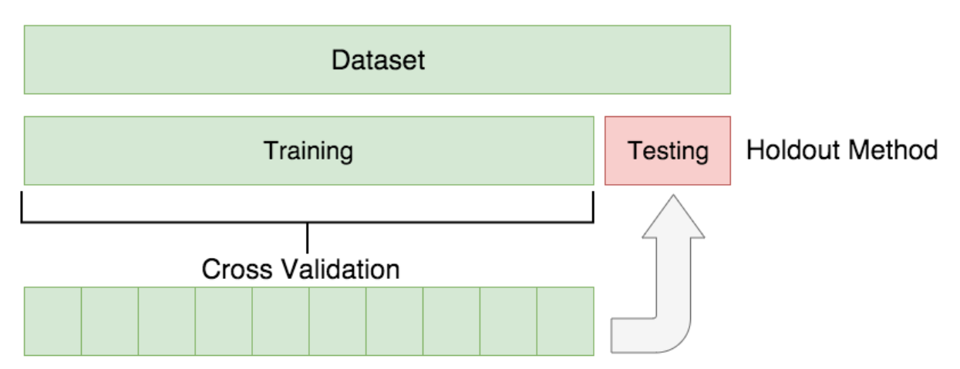
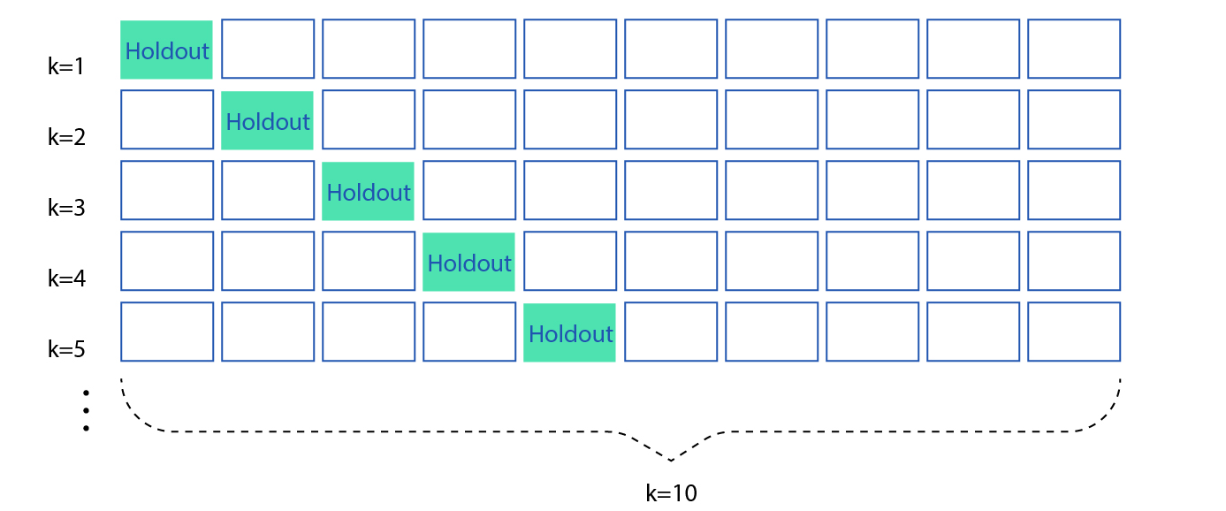
Cross Validation
Each method relies on test/train split to tune model parameters
This step introduces bias from selecting some data over others (random)
Cross validation performs the test/train split multiple times, reducing randomness from the model training

Slide 32
Library Generation
Extensive MCNP simulations
Center for Engineering Applications of Radioisotopes (CEAR) cluster – reduced run times from 1.5-3 days to ~1 hour
F8 tally for gamma detection
No GEB
Detector Response Function (Gardner and Sood, 2004)
Expected response generated in a detector from incident radiation
Non-linearities resolved to treat problem as a linear combination of library inputs
Gaussian broadening fit of full width/half max using calibration sources
Energy to channel conversion (2nd order polynomial in the following examples)

Slide 33
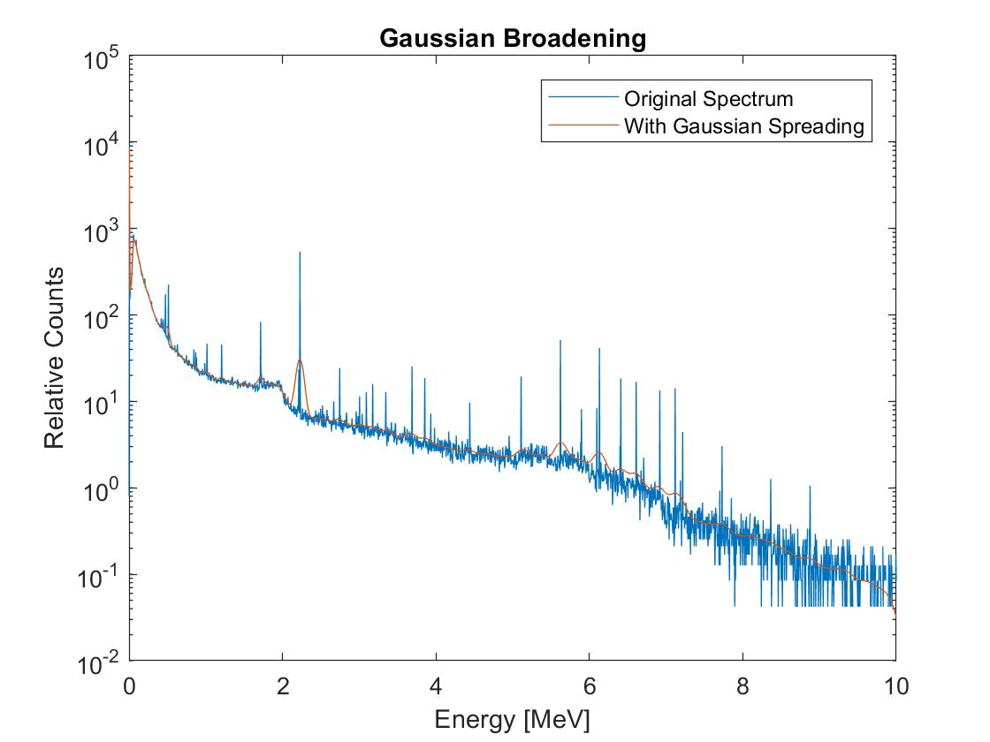
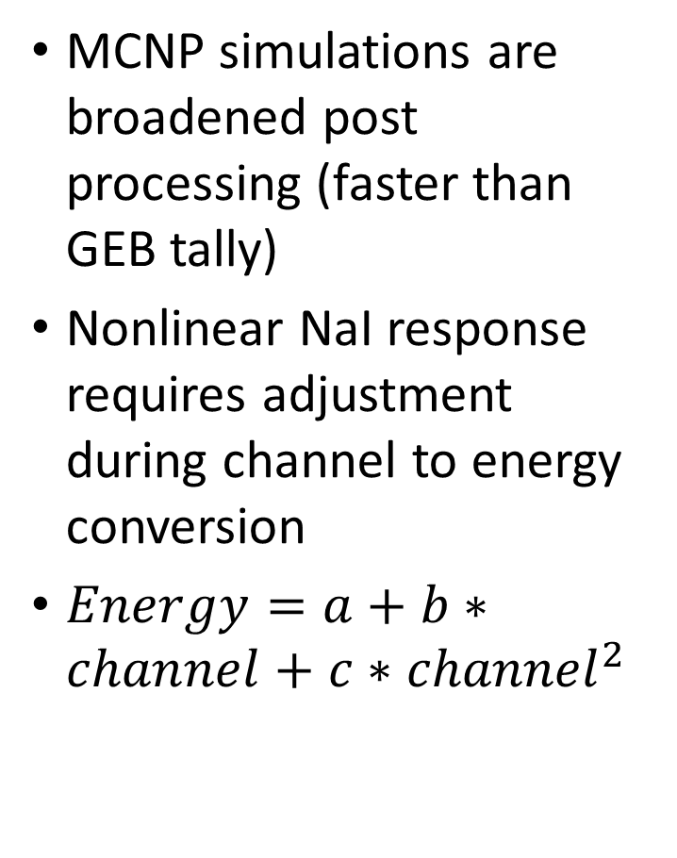
Processing of Data
MCNP simulations are broadened post processing (faster than GEB tally)
Nonlinear NaI response requires adjustment during channel to energy conversion
$Energy=a+b∗channel+c∗{channel}^{2}$

Slide 34
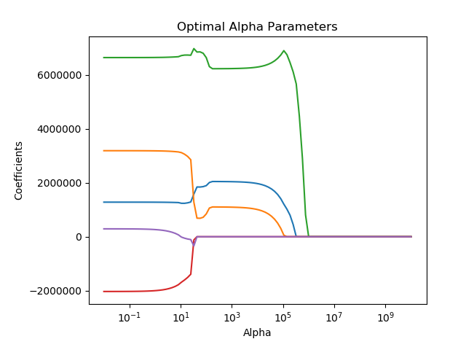
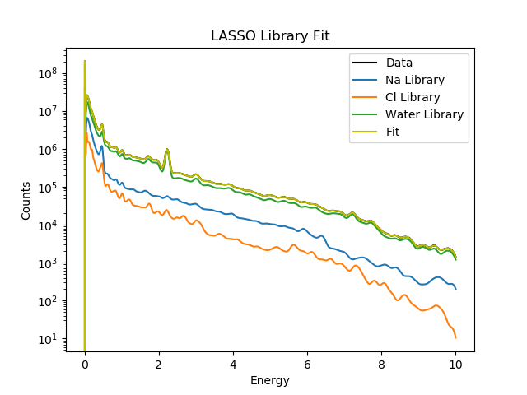
LASSO Simulated Example
Note: 5 libraries are used. Fe and Cu do not contribute to the total spectrum, are given a 0 contribution and selected out of the final model.

Slide 35
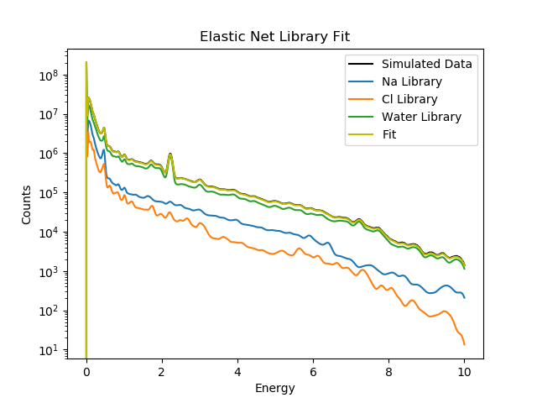
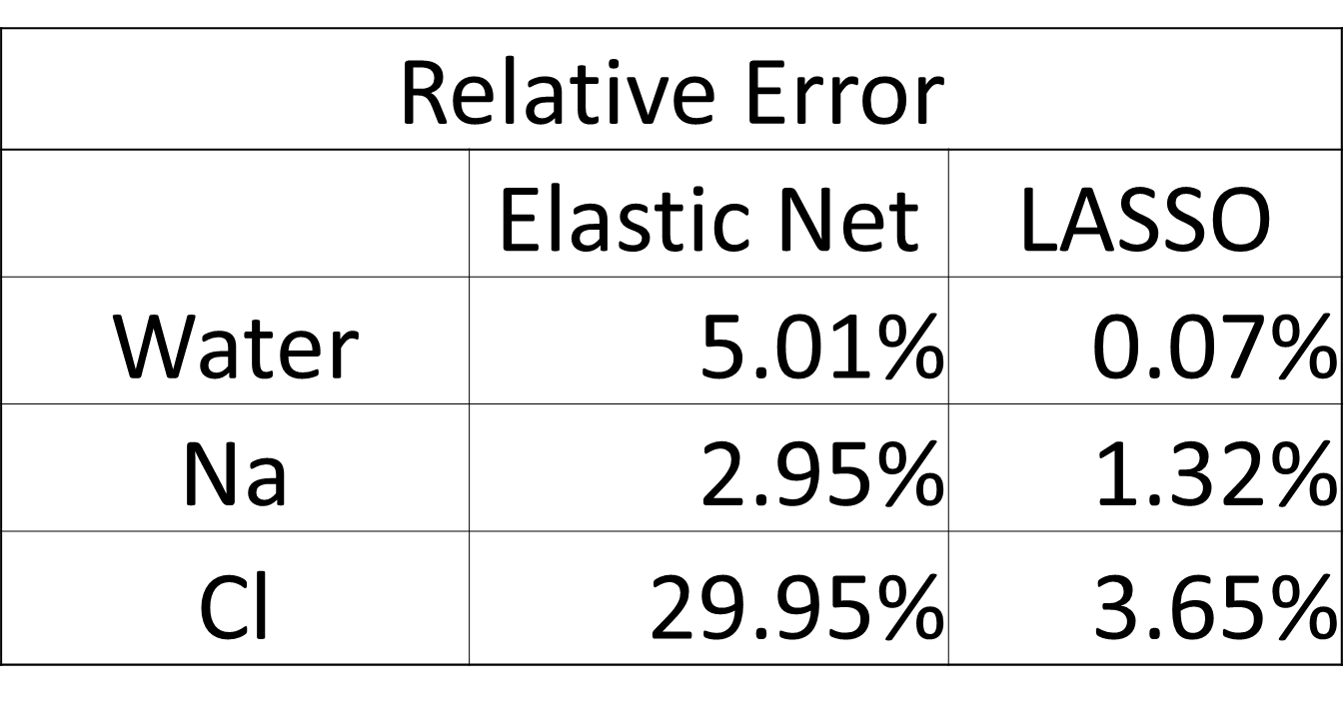
Elastic Net Simulation and Comparison

Slide 36
Full Run Flow Chart
Simulated and experimental data is generated
Each set is processed
Nonlinearities removed
Prompt/delayed responses are extracted
Test/train split data for model selection
Variable selection through LASSO or Elastic Net remove unnecessary model parameters and provides initial guesses
Final ordinary least squares fitting to reduce bias from model selection procedure
Experimental Data Collection
MCNP Library Generation
Process Data
Account for Nonlinearity
Test/Train Split
Perform Variable Selection
Ordinary Least Squares Fitting

Slide 37
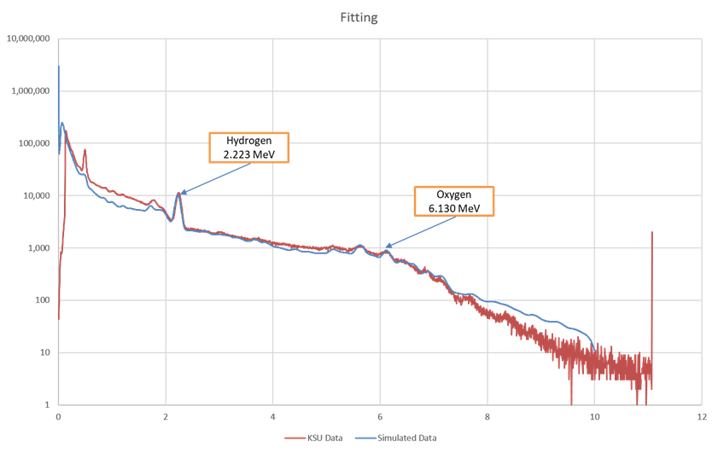
First Experimental Fit - Water

Slide 38
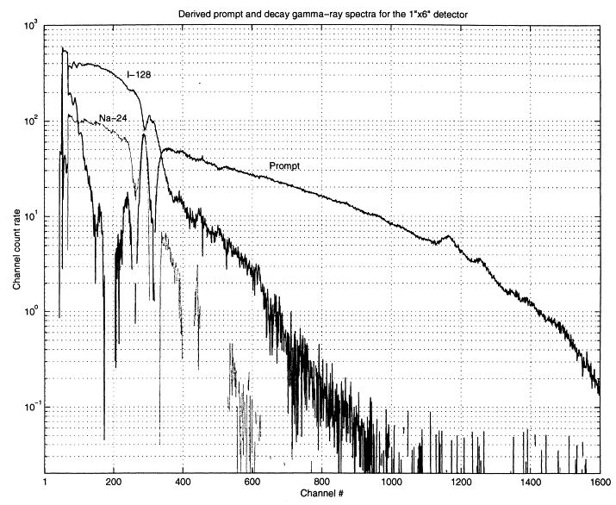
Gardner and Mayo, 2000
Activated NaI detector using NC State PULSTAR reactor
Detector activation is common during PGNAA
I-128 more sensitive than Na-24
β particle emission difficult to simulate using MCNP

Slide 39
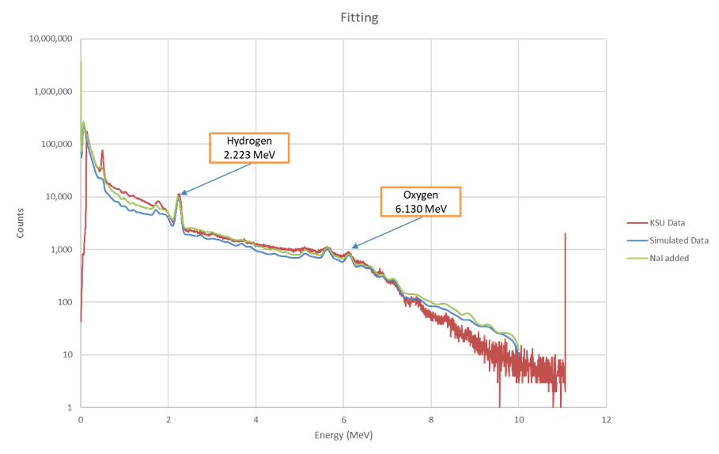
Results With NaI Activation - Water

Slide 40
Pulsed Neutron Generator (PNG) die-off time
Pulse from PNG
Increase in gamma rays from inelastic scatter and neutron capture
After 15-20 microseconds, inelastic gamma rays no longer contribute to total spectrum
Neutron capture gamma rays continue exponential decrease until next pulse

Slide 41
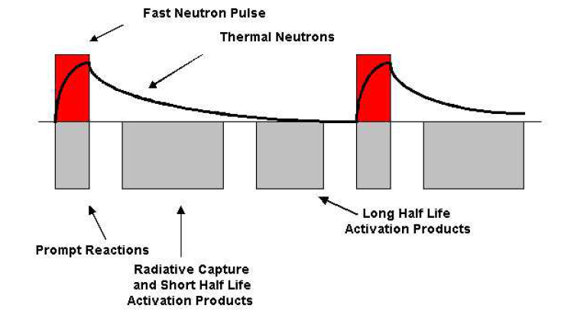
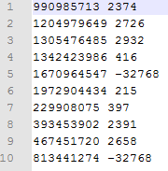
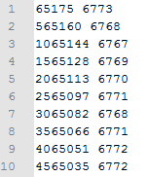
Representative Test Results: Water Sample
Events list
Triggers list
Expected Physics
Expected Physics: Die-away
Observed reactions
Observed prompt and delay gammas

Slide 42
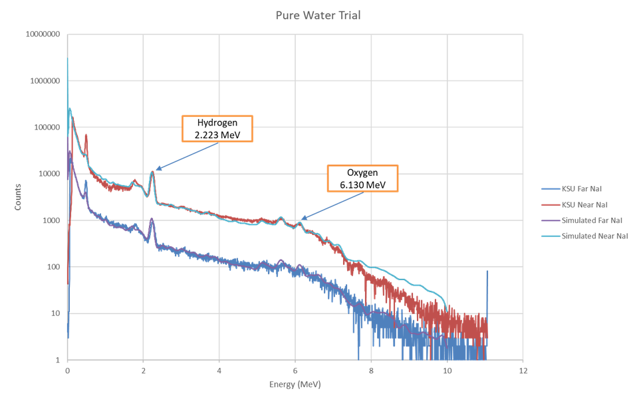
Water Trial – Background Removed

Slide 43
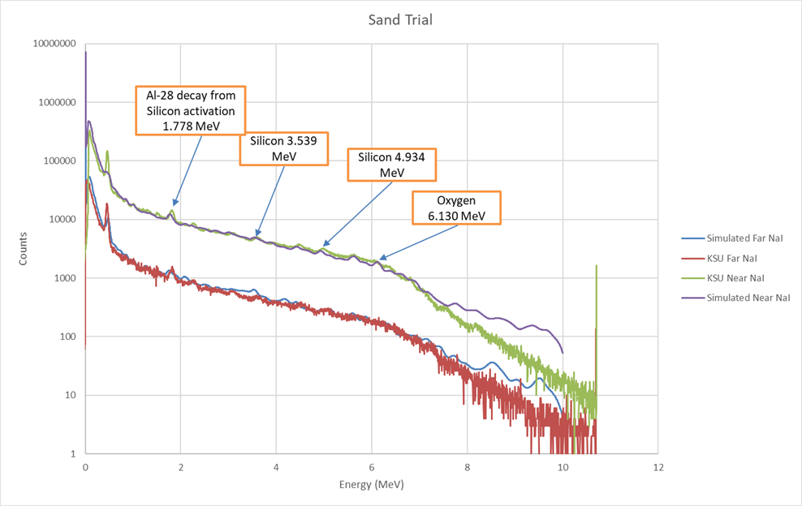
Sand Trial – Background Removed

Slide 44
Continuing Work on KSU Benchmarking Tool
Incorporate work from Aaron Feinberg and Long Vo
Bayesian approach to fit all non-linear components
Time dependent digitizer data
Analyze additional trials run at KSU
Limestone
Multiple porosities, water content

Slide 45
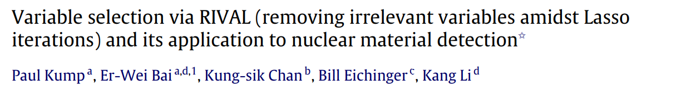
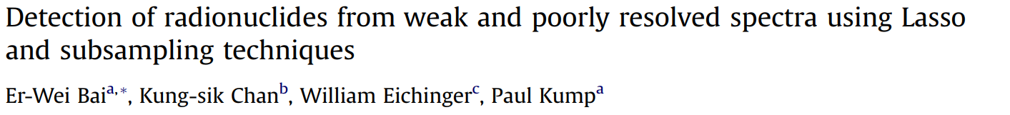
Extensive Simulation Test
2 papers on using LASSO technique on radiation detectors, 0 on Elastic Net
Ongoing work with extensive testing of the limitations of LASSO and Elastic Net using RIID simulations
High, medium, low counting situations
Vary number of radioisotopes
Vary number of channels
Shielding situations

Slide 46
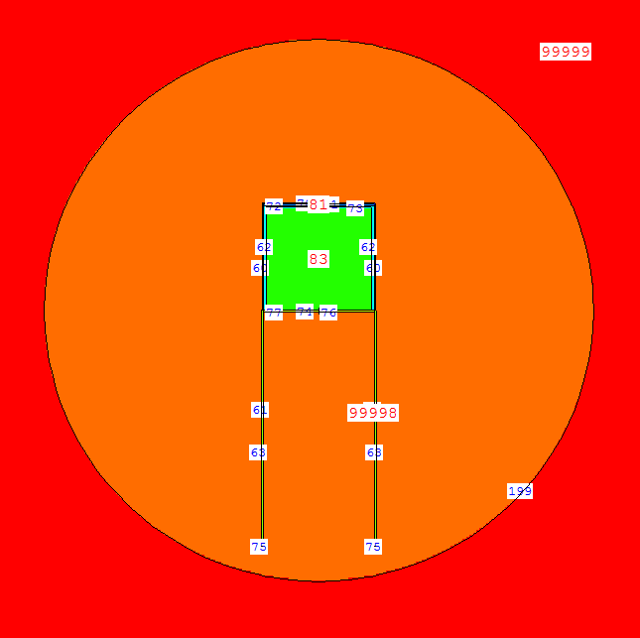

RIID Simulation Example
Test situation with 5 radionuclides
Each contribution is equal to 10000 except
Ba-133 contribution is 0

Slide 47


Example Continued – LASSO
Best for alphas:
0.001194672257786051
Coefficients:
Mn54 9167.226432
Ba133 0.000000
Co57 9943.454654
Co60 11975.977717
Na22 7416.615954
dtype: float64
MSE: 3.6450077532208525
Note: Ba-133 was removed as a variable correctly

Slide 48


Example Continued – Elastic Net
Best for alphas:
0.010507786919697218
Coefficients:
Mn54 10144.156552
Ba133 0.000000
Co57 9169.853788
Co60 7652.089759
Na22 10578.335376
dtype: float64
MSE: 7.48473481999024
Note: Ba-133 was removed as a variable correctly

Slide 49
Work Summary/Proposal
Coding packages are complete
Simulations are 80% complete
Kansas State experiment (40-60% complete)
Data has been collected
2 data sets evaluated
Simulations complete
Basic fitting complete
Receive and evaluate further data sets
Incorporate work from Aaron and Long
Look further into tuning parameters, alternate calibration for improved fits
Finalize full evaluation
Publish results in paper #1
RIID simulation (20% complete)
Test limitations for each method
Evaluate tuning parameters when more data is added
Add shielding to problem to test how well it predicts under poor assumptions
Publish results in paper #2

Slide 50
References
A.M. Yacout, R.P. Gardner, K. Verghese, Nucl. Instr. And Meth. A 243 (1986) 121.
A.Sood, R.P.Gardner / Nucl. Instr.and Meth.in Phys. Res.B 213 (2004) 100–104.
Bob Burkhart, “Neutron Generator and Well Logging”, Sandia National Laboratories, SAND2006-3291C, www.osti.gov/servlets/purl/1264595
Committee on Radiation Source and Replacement, 2008, Radiation Source Use and Replacement, National Research Council, ISBN 0-309-110115-7, National Academies Press, Washington, DC (NAS-2008)
E. Bai, K. Chan, W. Eichinger, P. Kump, “Detection of radionuclides from weak and poorly resolved spectra using Lasso and subsampling techniques.” Radiation Measurements, 46 (2011), pp. 1138-1146.
Evans, R.D., The Atomic Nucleus. McGraw-Hill, 1955.
Gardner, et al., 2013, ANS Panel on “Recent Developments in Radiation Source Use and Replacement after the NAS Report of 2008”, Transactions of the American Nuclear Society, Vol. 109, 47.
R.P. Gardner and A. Sood. “A Monte Carlo simulation approach for generating NaI detector response functions (DRFs) that accounts for non-linearity and variable flat continua”. Nuclear Instruments and Methods in Physics Research, Section B: Beam Interactions with Materials and Atoms 2013 *Jan. 2004), pp. 87-99.
R.P. Gardner and C.W. Mayo. “Nai detector nonlinearity for PGNAA applications”. Applied Radiation and Isotopes 51.2 (Aug. 1999), pp. 189-195.
Han, Xiaogang, Ph.D thesis. North Carolina State University. 2005.
Hastie, Trevor. The Elements of Statistical Learning: Data Mining, Inference, and Prediction. 2nd Edition. Springer Series in Statistics. 2009.
Hou, Guojing, Ph.D thesis. North Carolina State University. 2017.
Knoll, G. F., Radiation Detection and Measurement. 4th Edition. John Wiley and Sons, Inc, 2011.
Liberman, A.D et. al., “A method to determine the absolute neutron output of small D-T generator”, Nuclear Instruments and Methods in Physics Research Section B, Volume 79, Issue 1-4, p. 574-578, June 1993
M. Geretschlager, Nucl. Instr. and Meth. B 28 (1987) 289.
MCNP Training Manual
Preston R.M. et al, “Neutron generator burst timing measured using a pulse shape discrimination plastic scintillator with silicon photomultiplier readout”, Journal of Instrumentation, December 8, 2013
R.P. Gardner, A.M. Yacout, J. Zhang, K. Verghese, Nucl. Instr. and Meth. A 242 (1986) 399.
R.L. Heath, Scintillation Spectrometry, Gamma-Ray Spectrum Catalogue, 2nd Ed., USAEC Report IDO-16880, 1964.
T. Papp, J.L. Campbell, D. Varga, G. Kalinka, Nucl. Instr. and Meth. A 412 (1998) 109.
Serra, Oberto. Well Logging Handbook. Ed. Technip, Paris. 2008.
Tibshirani, R. “Regression shrinkage and selection via the lasso.” Journal of the Royal Statistical Society, Series B 58: 267-288. 1996.
Y. Jin, R.P. Gardner, K. Verghese, Nucl. Instr. and Meth. A 242 (1986) 416.
Zou, H. and Hastie, T. “Regularization and variable selection via the elastic net”. Journal of the Royal Statistical Society Series B. 67: 301-320. 2005.

Slide 51
Discussion
Questions?

